Slide 1
DESIGN AND ANALYSIS OF DISK BRAKE
Members:
Nikhil kadam
Kiran kumar
Sreenivas
Manohar

Slide 2
Objectives set for the project
Strength analysis for the disc brakes
Temperature analysis of the disc brakes
Vibrational analysis of the disc brakes

Slide 3
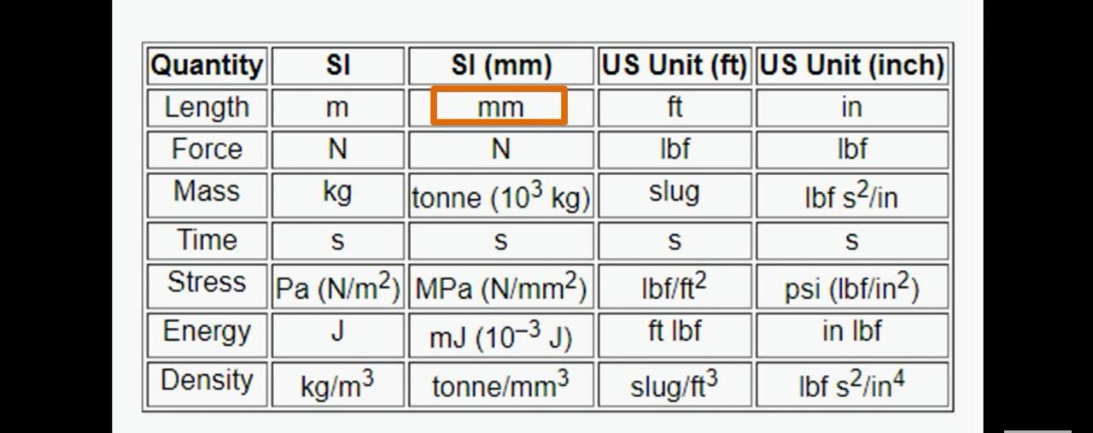
Progress
Studied and made a report of working of the disc brakes
We got know that disc brakes are not facing any problems regarding strength
We focused on the study of temperature analysis
Firstly, we started working with abaqus software.
It really took a lot of time to cope up with abaqus as its units cannot be set by a user,they are standardized as shown in figure
We made a normal model without holes in a disc brake and made temperature analysis on the basis of an you tube video(https://www.youtube.com/watch?v=RRFJSY_fybs&feature=youtu.be)

Slide 4
Finally we are analysing a disc brake model with holes.

Slide 5
Individual contribution
Nikhil kadam: He was studying research papers about the vibrations and their effect in disc brakes.
Kiran : He was managing the group and helped to learn the software.
Sreenivas & Manohar: They studied the working of disc brakes , made a report on it(materials used ) etc. They made a model which we used for analysis purpose.

Slide 6
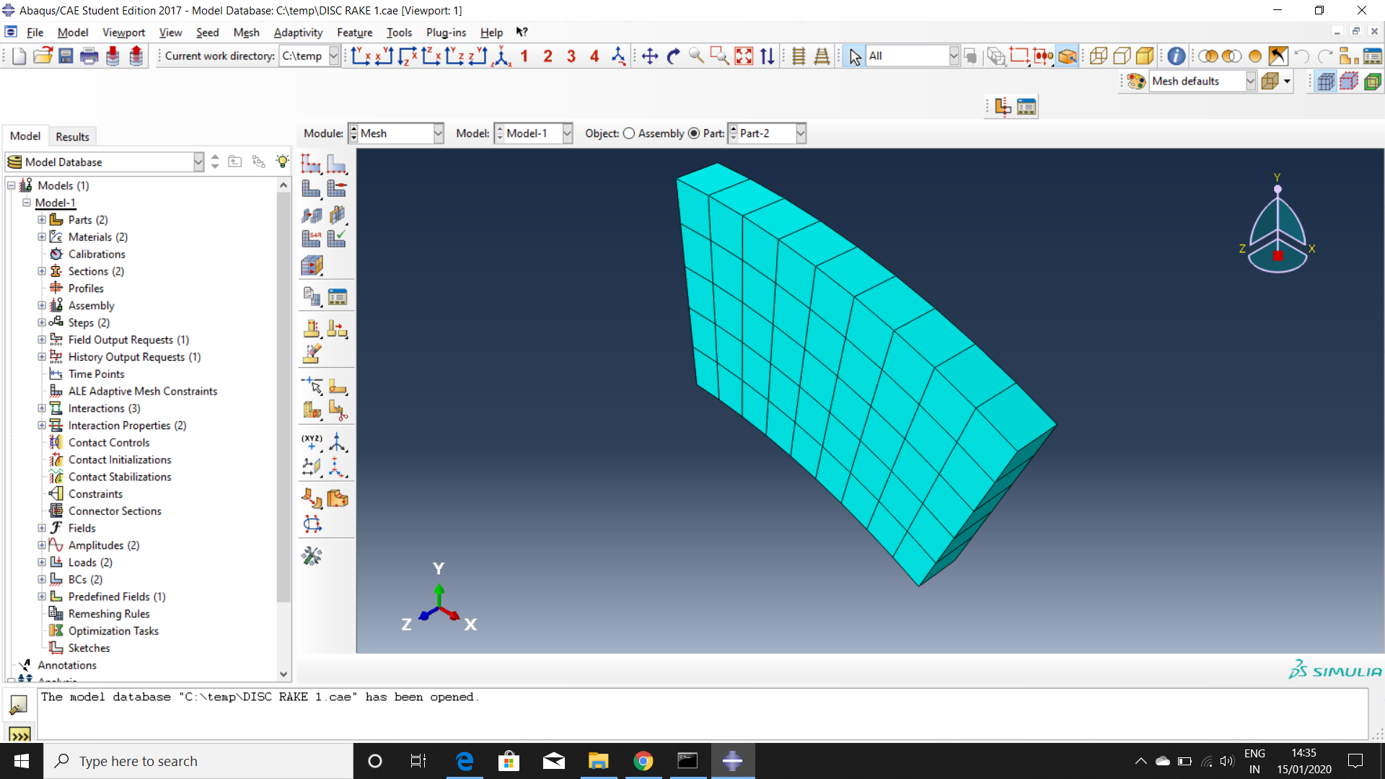
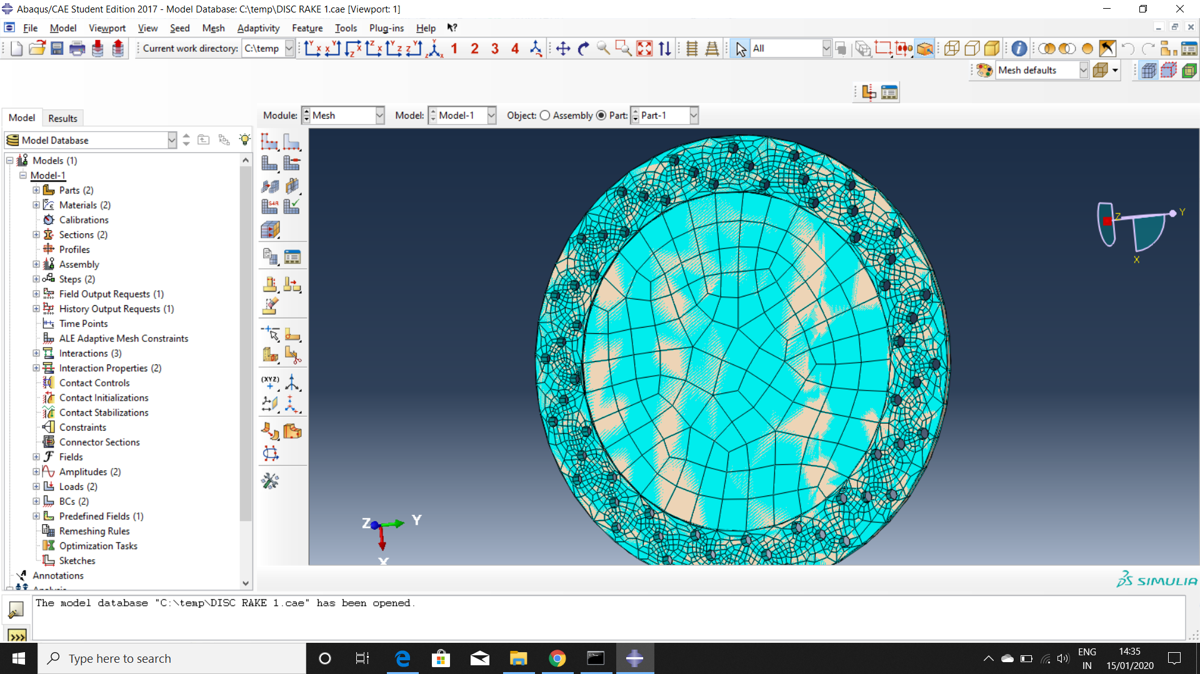
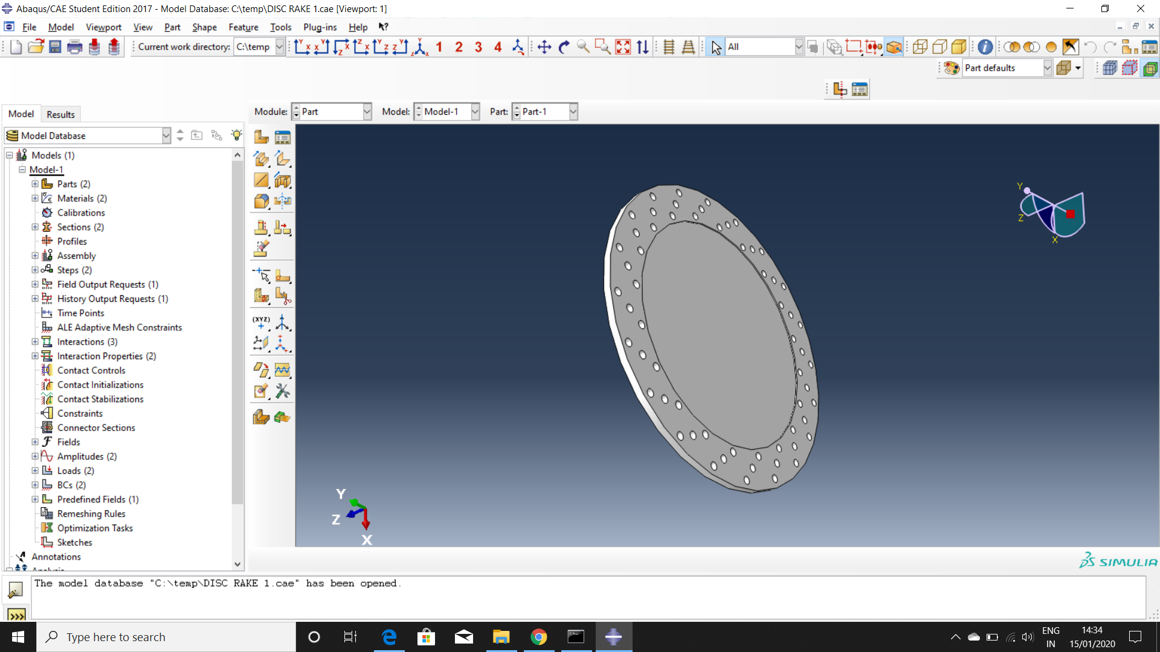
Designs ( Materials: SUS 410, Semi metallic)

Slide 9
Future Plan
Complete the temperature analysis-Jan 31.
Study and complete the vibrational analysis - after a week a of mid sem.
Propose a design a model which overcomes the two problems caused by the temperature and vibration - By the mid of March.

